Slide 1
Thesis Title
(example) Ph.D. Mid-Candidature Review)
Stage 2: Exploring …
Candidate:
Name
Supervisors:
Name
Name

Slide 2
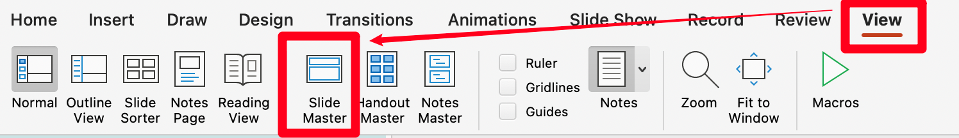
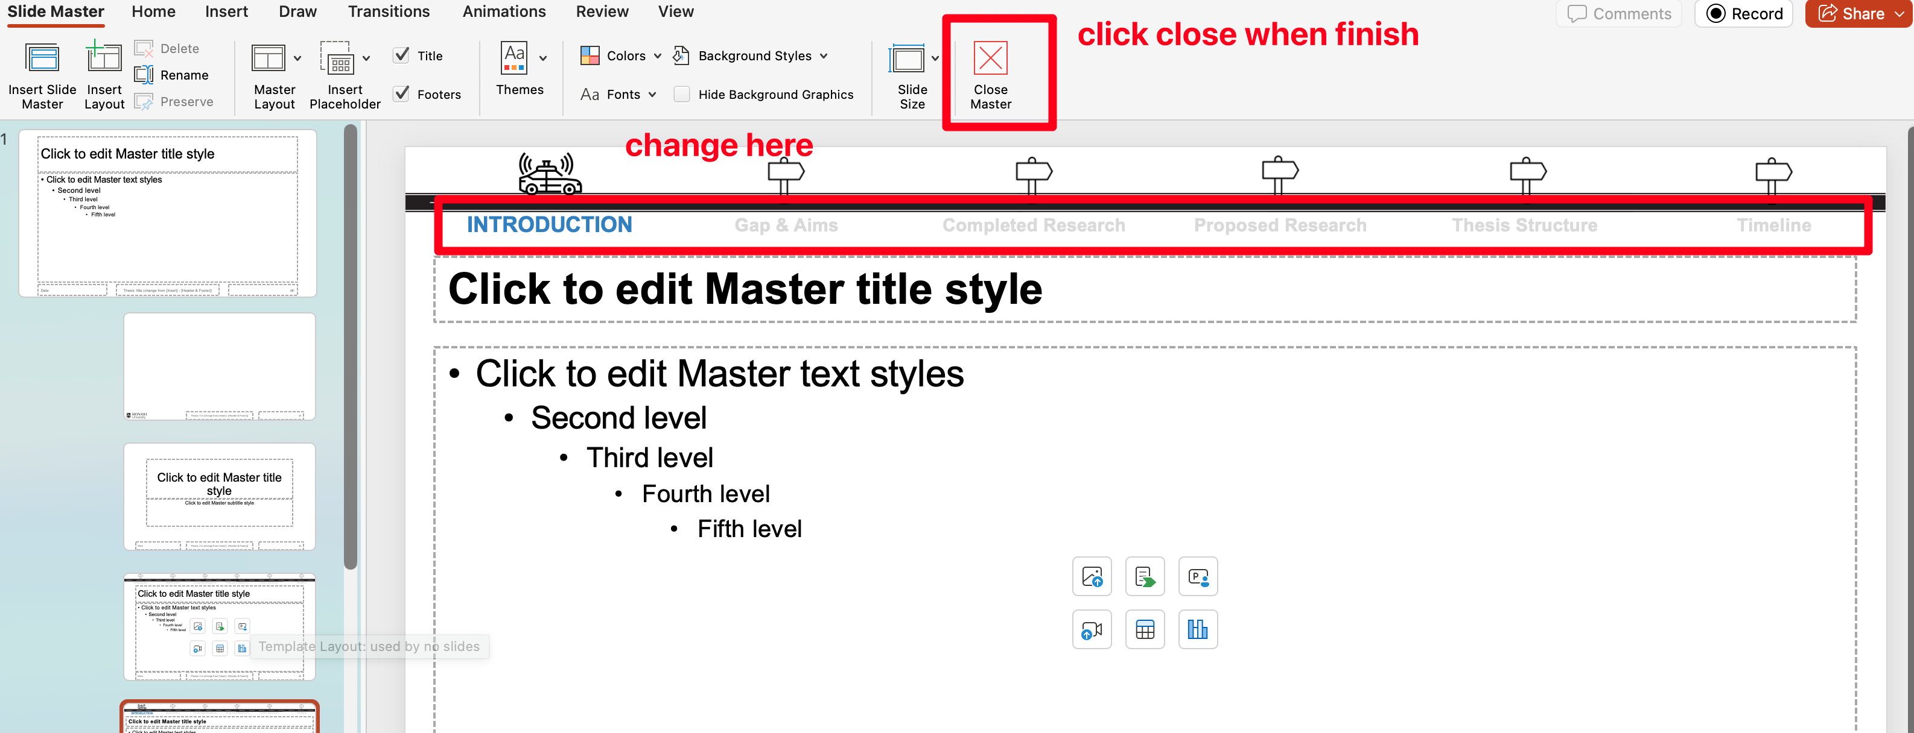
To change the headers ☝
Go to [View] → [Slide Master]

